Slide 1
Msc CS project
By Stuart Macgregor

Slide 2
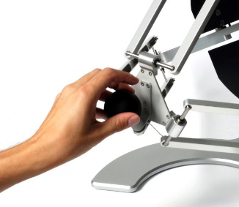
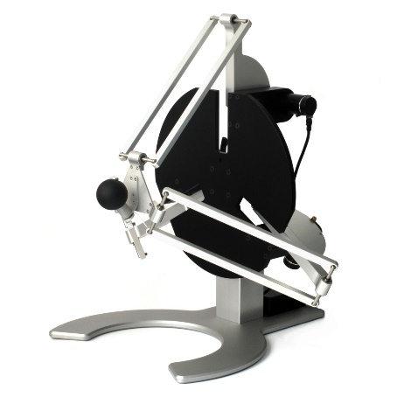
Project aim
Improve upper limb rehabilitation process through use of Virtual reality and haptic feedback
Contribute to the field of neurorehabilitation
Notes:
Create a VR immersive environment where individuals with neurological conditions, such as sensory motor deficiency post stroke, can participate in exercises to retrain motor control
Use of delta robot to provide force feedback during exercises in target reaching or tracking
Overall goal is to contribute to the field of neurorehabilitation by utilising virtual reality and haptic technology to facilitate rehabilitation of motor control

Slide 3

Motivation
Significant advancements in drug development
Increased demand for rehabilitation
Notes:
resulted in greater number of patients requiring rehabilitation while health care budgets remain limited
Examples of this:
This is because of the increase in individuals surviving conditions that lead to physiological impairments such as strokes, who then require rehabilitation
Aging population and increased prevalence of risk factors for stroke such as diabetes and hypertension having further increased the demand for rehabilitation services

Slide 4
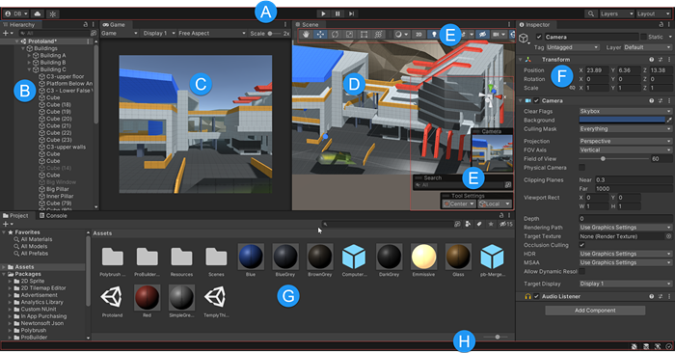
Tackling the problem
Integration of technology
Rewards and incentives using unity game engine
Haptic feedback
Notes:
- using virtual reality to create and immersive environment for therapy, making it more practical for patients to interact with engaging exercises in a realistic manner
using rewards and creating a game like experience to keep patients engaged and encourage participation to help them keep motivated and achieve their rehabilitation goals
Using unity game engine to design and create the VR exercises, and applying these to the haptic devices
Haptic feedback will be given by a delta robot which will provide force feedback to upper limbs for example:
supportive forces or resistive forces can be applied to assist the patient’s rehabilitation progress. This can be changed depending on the patient’s sensory motor ability
Involves determining the appropriate supportive an resistive forces to be applied during tasks

Slide 5

Challenges
Choosing and maintaining a focus point for my project e.g
Integration of haptic devices with game exercises and tracking systems
Notes:
Integration of the haptic devices, motion tracking systems could present technical difficulties. Ensuring these components are synchronised may require thorough testing and trouble shooting
Choosing a focus point on what my project can produce with limited time availability
E.g use of hand tracking to monitor progress of patients or use of EEG to see which areas of the brain are stimulated
E.g designing and implementation of force feedback. Involves determining the appropriate supportive an resistive forces to be applied during tasks
Task customisation: tailoring difficulty level to the patients ability to ensure a personalised rehabilitation experience

Slide 6

Managing challenges
Time management
Seek help and support to solve integration issues
Research and breakdown areas of potential focus points for my project
Notes:
Allocate sufficient time to integrate haptic devices and progress tracking systems. If I struggle seek out help and support to help solve these problems
Research and breakdown focus points of my project and make a realistic choice as to which area will be realistic main focus, and which ones I may be minor focus for the over all project given the time frame I have

Slide 7

Evaluation
Assess the quality originality and effectiveness of my research
Evaluate methodology and research design
What is the overall contribution and impact in the project field

